Slide 1
Theory of Firm
References
1. Pindyck & Rubinfeld
2. Gravelle & Rees

Slide 2
Cost of production
● Isocost line Graph showing all possible combinations of labor and capital that can be purchased for a given total cost.
The total cost of producing any particular output is given by the sum of the firm’s labor cost and its capital cost:
is the budget constraint of the firm.
It follows that the iso-cost line has a slope of ΔK/ΔL = −(w/r), which is the ratio of the wage rate to the rental cost of capital.

Slide 3


Cost Minimization
The cost-minimization problem can be written as
$$\text{Minimize} \text{C}=wL+rK$$
(1)
subject to the constraint that a fixed output q₀ be produced:
$$F\left(K, L\right)=q_{0}$$
(2)

Slide 4
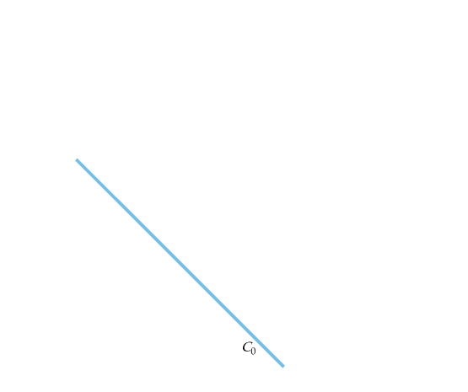
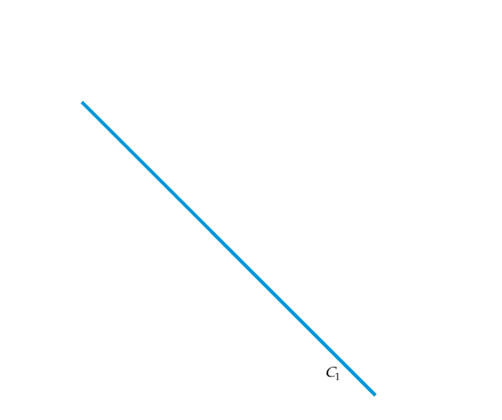
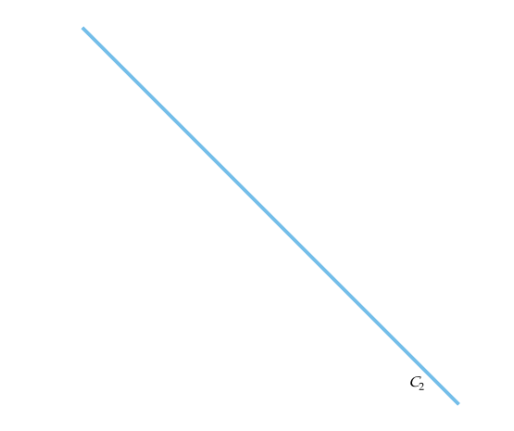
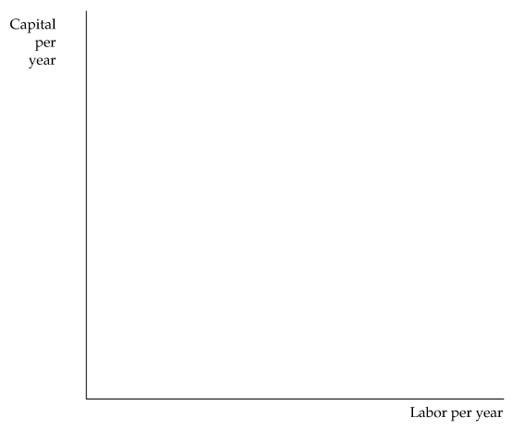
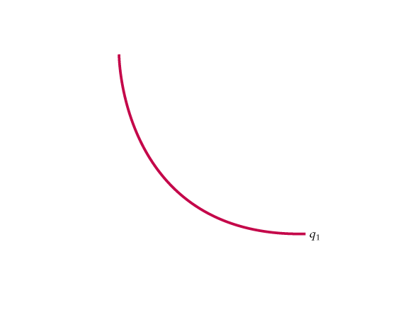
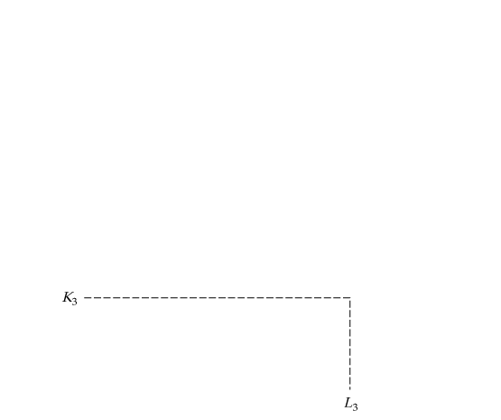
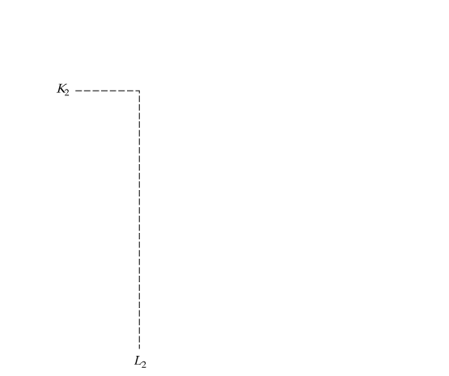
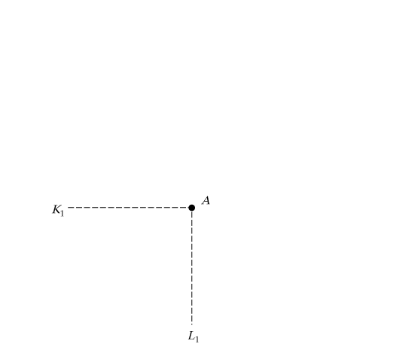
Producing a Given Output at Minimum Cost
Isocost curves describe the combination of inputs to production that cost the same amount to the firm.
Isocost curve C₁ is tangent to isoquant q₁ at A and shows that output q₁ can be produced at minimum cost with labor input L₁ and capital input K₁.
Other input combinations–L₂, K₂ and L₃, K₃–yield the same output but at higher cost.

Slide 5



COST IN THE LONG RUN
Choosing Inputs
Recall that the marginal rate of technical substitution of labor for capital (MRTS) is the negative of the slope of the isoquant and is equal to the ratio of the marginal products of labor and capital:
It follows that when a firm minimizes the cost of producing a particular output, the following condition holds:
We can rewrite this condition slightly as follows:

Slide 6
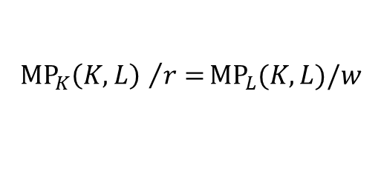
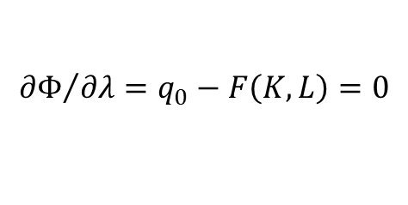
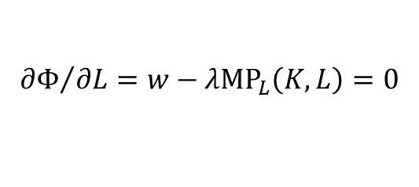
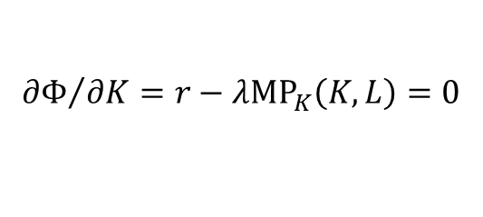
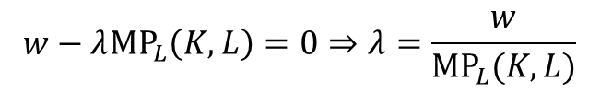

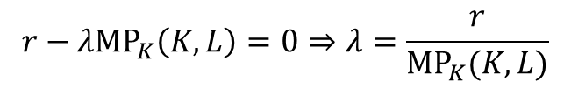
Algebraic Treatment
Step 1: Set up the Lagrangian.
$$Φ=wL+rK−λ[F\left(K, L\right)−q_{0}]$$
(3)
Step 2: Differentiate the Lagrangian with respect to K, L, and λ and set equal to zero.
$${∂Φ}/{∂K=r−λ{\text{MP}}_{K}\left(K, L\right)=0}$$
$${∂Φ}/{∂L=w−λ{\text{MP}}_{L}\left(K, L\right)=0}$$
(4)
$${∂Φ}/{∂λ=q_{0}−F\left(K, L\right)=0}$$
Step 3: Combine the first two conditions in (4) to obtain
$${{{\text{MP}}_{K}\left(K, L\right) }/{r=}\text{MP}}_{L}(K, L)/w$$
(5)
Rewrite the first two conditions in (4) to evaluate the Lagrange multiplier:
$$r−λ{\text{MP}}_{K}\left(K, L\right)=0⇒λ=\frac{r}{{\text{MP}}_{K}(K, L)}$$
$$w−λ{\text{MP}}_{L}\left(K, L\right)=0⇒λ=\frac{w}{{\text{MP}}_{L}(K, L)}$$
(6)
r/MP_{K}(K, L) measures the additional input cost of producing an additional unit of output by increasing capital, and w/MP_{L}(K, L) the additional cost of using additional labor as an input. In both cases, the Lagrange multiplier is equal to the marginal cost of production.

Slide 7
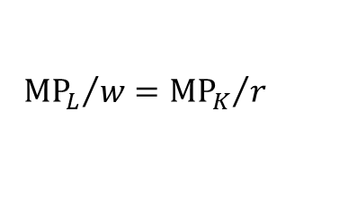
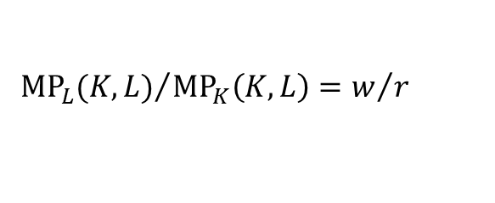
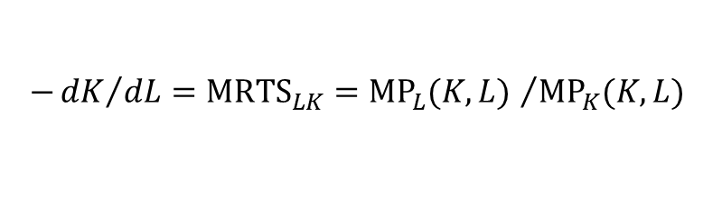


Marginal Rate of Technical Substitution
Write the isoquant:
$${\text{MP}}_{K}\left(K, L\right)dK+{\text{MP}}_{L}dL=dq=0$$
(7)
(8)
Rearrange terms:
$$−{dK}/{dL}={\text{MRTS}}_{LK}={{\text{MP}}_{L}(K, L) }/{{\text{MP}}_{K}(K, L) }$$
Rewrite the condition given by (5) to get
$${{\text{MP}}_{L}(K, L)}/{{\text{MP}}_{K}\left(K, L\right)=w/r }$$
(9)
Rewrite (9):
$${{\text{MP}}_{L}}/w={{\text{MP}}_{K}}/r$$
(10)
Duality in Production and Cost Theory
The dual problem asks what combination of K and L will let us produce the most output at a cost of C₀.
$$\text{Maximize} F\left(K, L\right) \text{subject} \text{to} wL+rL=C_{0}$$
(11)
Step 1: Set up the Lagrangian.
$$Φ=F(K, L)−\text{μ}(wL+rK−{\text{C}}_{0})$$
(12)

Slide 8
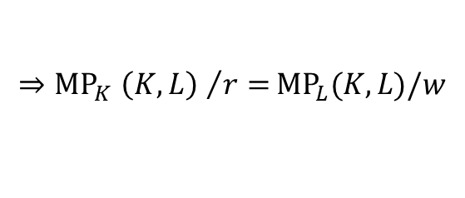
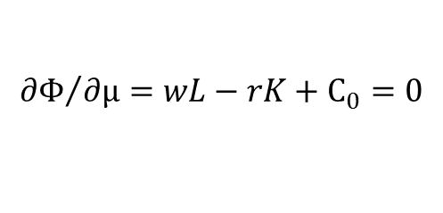
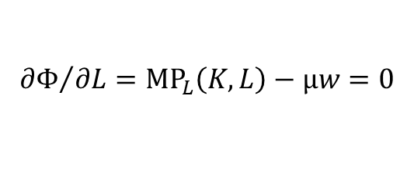
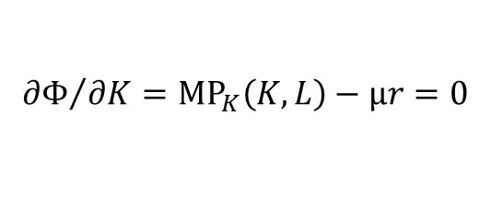
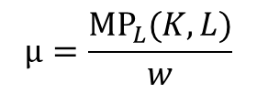
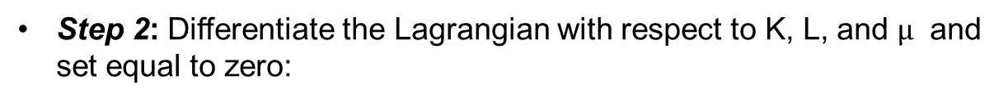
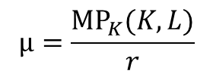
Step 2:Differentiate the Lagrangian with respect to K, L, and $\text{μ}$ and set equal to zero:
$${∂Φ}/{∂K={\text{MP}}_{K}\left(K, L\right)−\text{μ}r=0}$$
$${∂Φ}/{∂L={\text{MP}}_{L}\left(K, L\right)−\text{μ}w=0}$$
(13)
$${∂Φ}/{∂\text{μ}=wL−rK+C_{0}=0}$$
Step 3: Combine the first two equations:
$$\text{μ}=\frac{{\text{MP}}_{K}(K, L)}{r}$$
$$\text{μ}=\frac{{\text{MP}}_{L}(K, L)}{w}$$
(14)
$${{{⇒\text{MP}}_{K}\left(K, L\right) }/{r=}\text{MP}}_{L}(K, L)/w$$
This is the same result as (5)—that is, the necessary condition for cost
minimization.

Slide 9


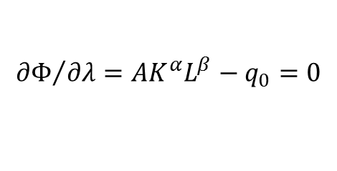
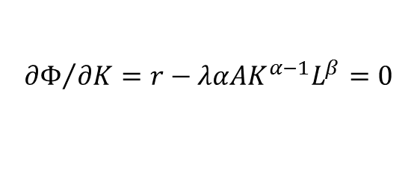
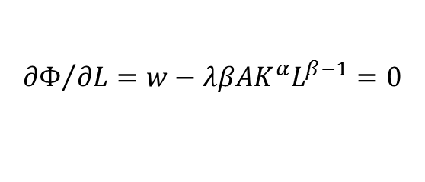
The Cobb-Douglas Cost and Production Functions
● Cobb-Douglas production function
$$F\left(K, L\right)={AK}^{α}L^{β}$$
To find the amounts of capital and labor that the firm should utilize to minimize
the cost of producing an output q₀, we first write the Lagrangian
$$Φ=wL+rK−λ[{AK}^{α}L^{β}−q_{0}]$$
(15)
Differentiating with respect to L, K, and λ, and setting those derivatives equal
to 0, we obtain
$${∂Φ}/{∂L=w−λβ{AK}^{α}L^{β−1}=0}$$
(16)
$${∂Φ}/{∂K=r−λα{AK}^{α−1}L^{β}=0}$$
(17)
$${∂Φ}/{∂λ={AK}^{α}L^{β}−q_{0}=0}$$
(18)

Slide 10
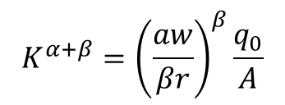
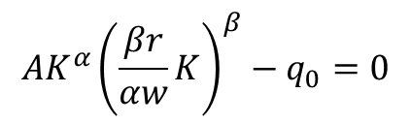


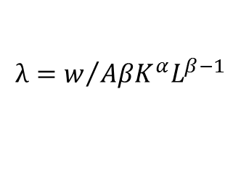
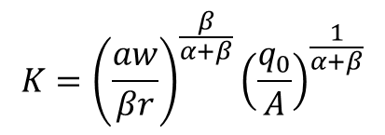
From equation (16) we have
$$λ=w/{AβK^{α}L^{β−1}}$$
(19)
Substituting this formula into equation (17) gives us
$$rβ{AK}^{α}L^{β−1}=wα{AK}^{α−1}L^{β}$$
(20)
or
$$L=\frac{βr}{αw}K$$
(21)
(21) is the expansion path. Now use Equation (21) to substitute for L in
equation (18):
$${{AK}^{α}\left(\frac{βr}{αw}K\right)}^{β}−q_{0}=0$$
(22)
We can rewrite the new equation as:
$$K^{α+β}={\left(\frac{aw}{βr}\right)}^{β}\frac{q_{0}}{A}$$
(23)
or
$$K={\left(\frac{aw}{βr}\right)}^{\frac{β}{α+β}}{\left(\frac{q_{0}}{A}\right)}^{\frac{1}{α+β}}$$
(24)

Slide 11
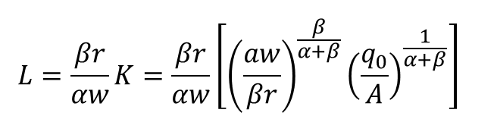
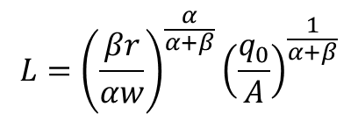
(24) is the factor demand for capital. To determine the cost-minimizing quantity of labor, we simply substitute equation (24) into equation (21):
$$L={\frac{βr}{αw}K=\frac{βr}{αw}\left[{\left(\frac{aw}{βr}\right)}^{\frac{β}{α+β}}{\left(\frac{q_{0}}{A}\right)}^{\frac{1}{α+β}}\right]}^{}$$
(25)
$$L={\left(\frac{βr}{αw}\right)}^{\frac{α}{α+β}}{\left(\frac{q_{0}}{A}\right)}^{\frac{1}{α+β}}$$

Slide 12
Cost Minimization with Varying Output Levels
● Expansion path Curve passing through points of tangency between a firm’s isocost lines and its isoquants.
The Expansion Path and Long-Run Costs
To move from the expansion path to the cost curve, we follow three steps:
Choose an output level represented by an isoquant. Then find the point of tangency of that isoquant with an isocost line.
From the chosen isocost line determine the minimum cost of producing the output level that has been selected.
Graph the output-cost combination.

Slide 13
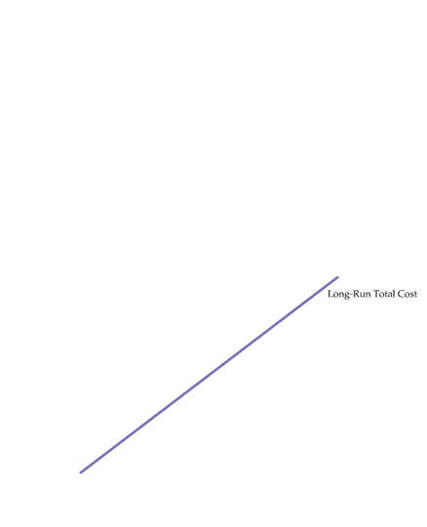
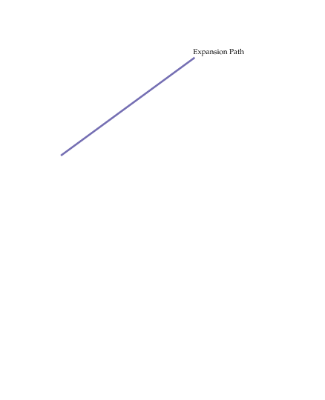
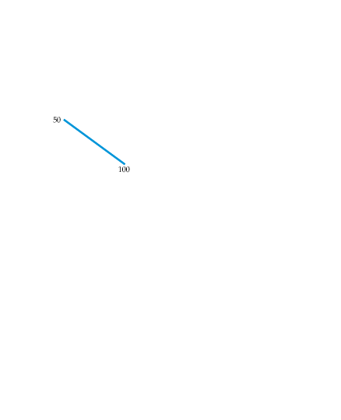

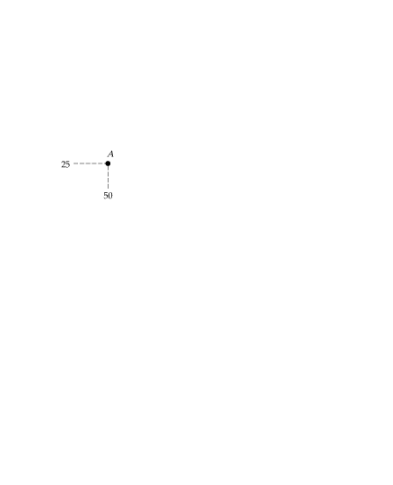
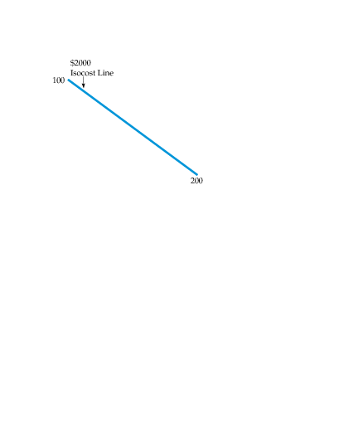
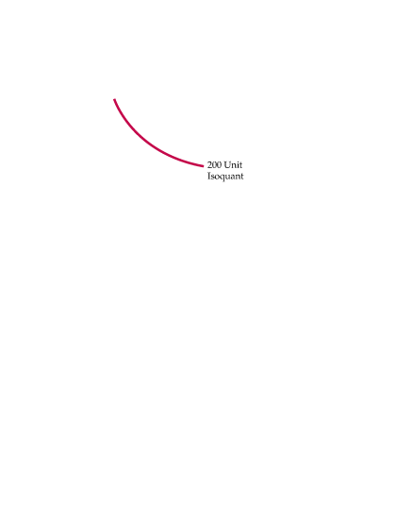
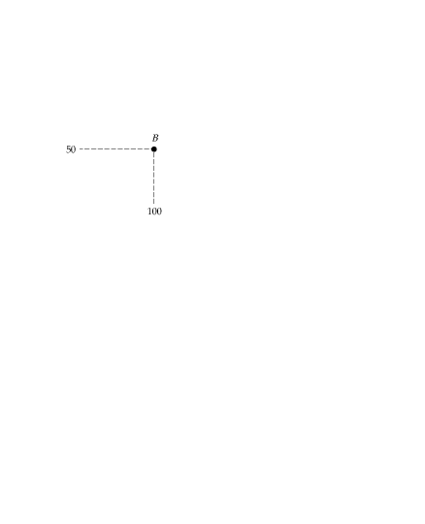
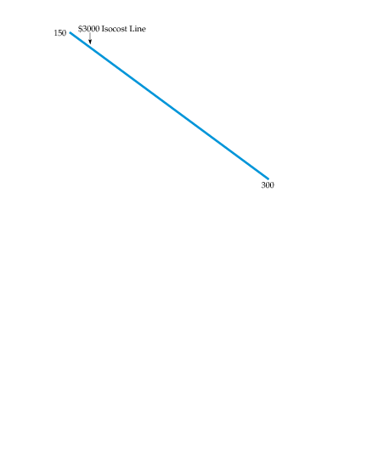
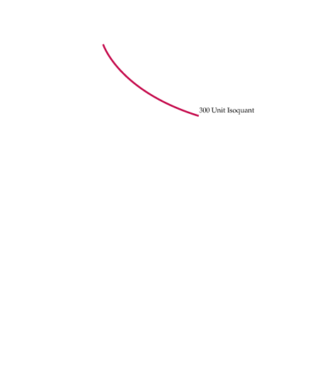
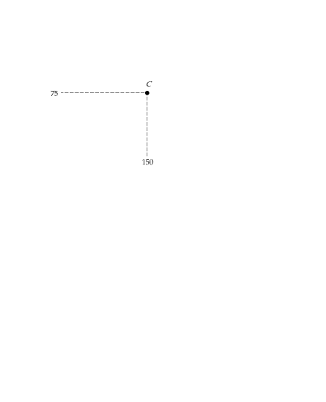
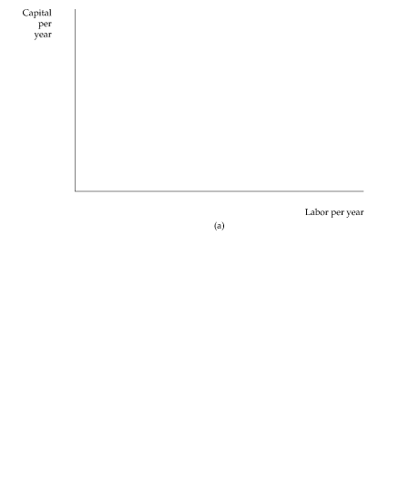
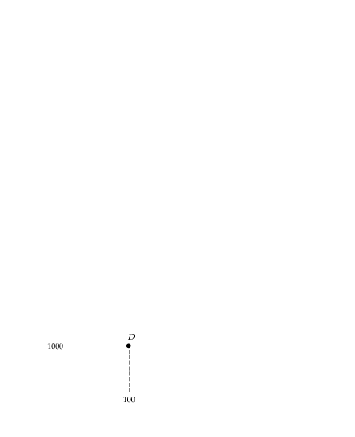
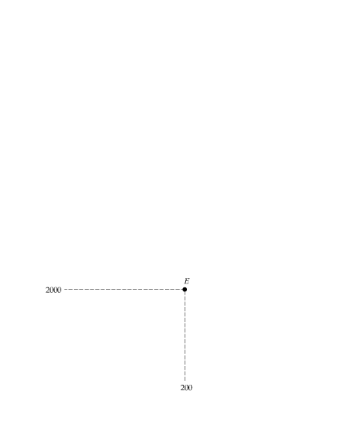
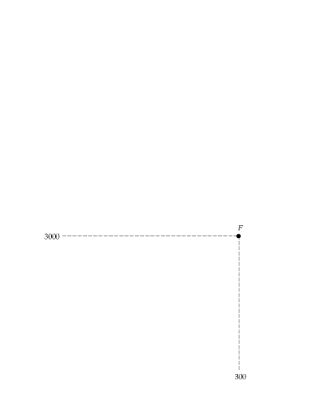
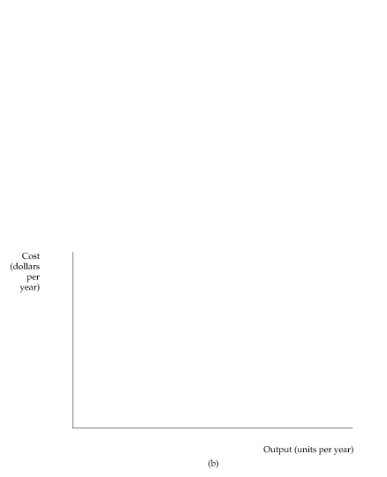
Cost Minimization with Varying Output Levels
A Firm’s Expansion Path and Long-Run Total Cost Curve
In (a), the expansion path (from the origin through points A, B, and C) illustrates the lowest-cost combinations of labor and capital that can be used to produce each level of output in the long run— i.e., when both inputs to production can be varied.
In (b), the corresponding long-run total cost curve (from the origin through points D, E, and F) measures the least cost of producing each level of output.

Slide 14
Expansion path
This is the least cost way of expanding scale of production to achieve successively higher level of output.
Equation of Expansion path:
MRTSLK = w/r
Hence Φ(K/L)=w/r
So we can write K=mL
Expansion path is straight line for a homogeneous production function.
Equilibrium choice of K/L is independent of the scale of output for a homogeneous production function.

Slide 15
Firm’s input choice: Comparative Statics
Let w falls, CP.
Q. How will demand for L change?
Decompose the total effect into two parts:
(I) Factor substitution effect: Substitution between L & K to attain the same level of output.
(II) Output effect: faced along the expansion path.
For homogeneous production function output effect >0 so both or all inputs are normal.
For non-homogeneous production function, demand for labour may fall (if L is inferior) due to output effect <0.

Slide 16
K
a
K*/L*
E0
E2
E1
c
d
L
Decomposition of Total Effect for homogeneous production function

Slide 17
K
a
Region II
E0
E2
E1
c
Region I
d
L
Region I: L is normal input, K is inferior input
Region II: K is normal input, L is inferior input

